Slide 1

Note Reader
Emmett Fitzharris
Notes:
Introduction

Slide 2
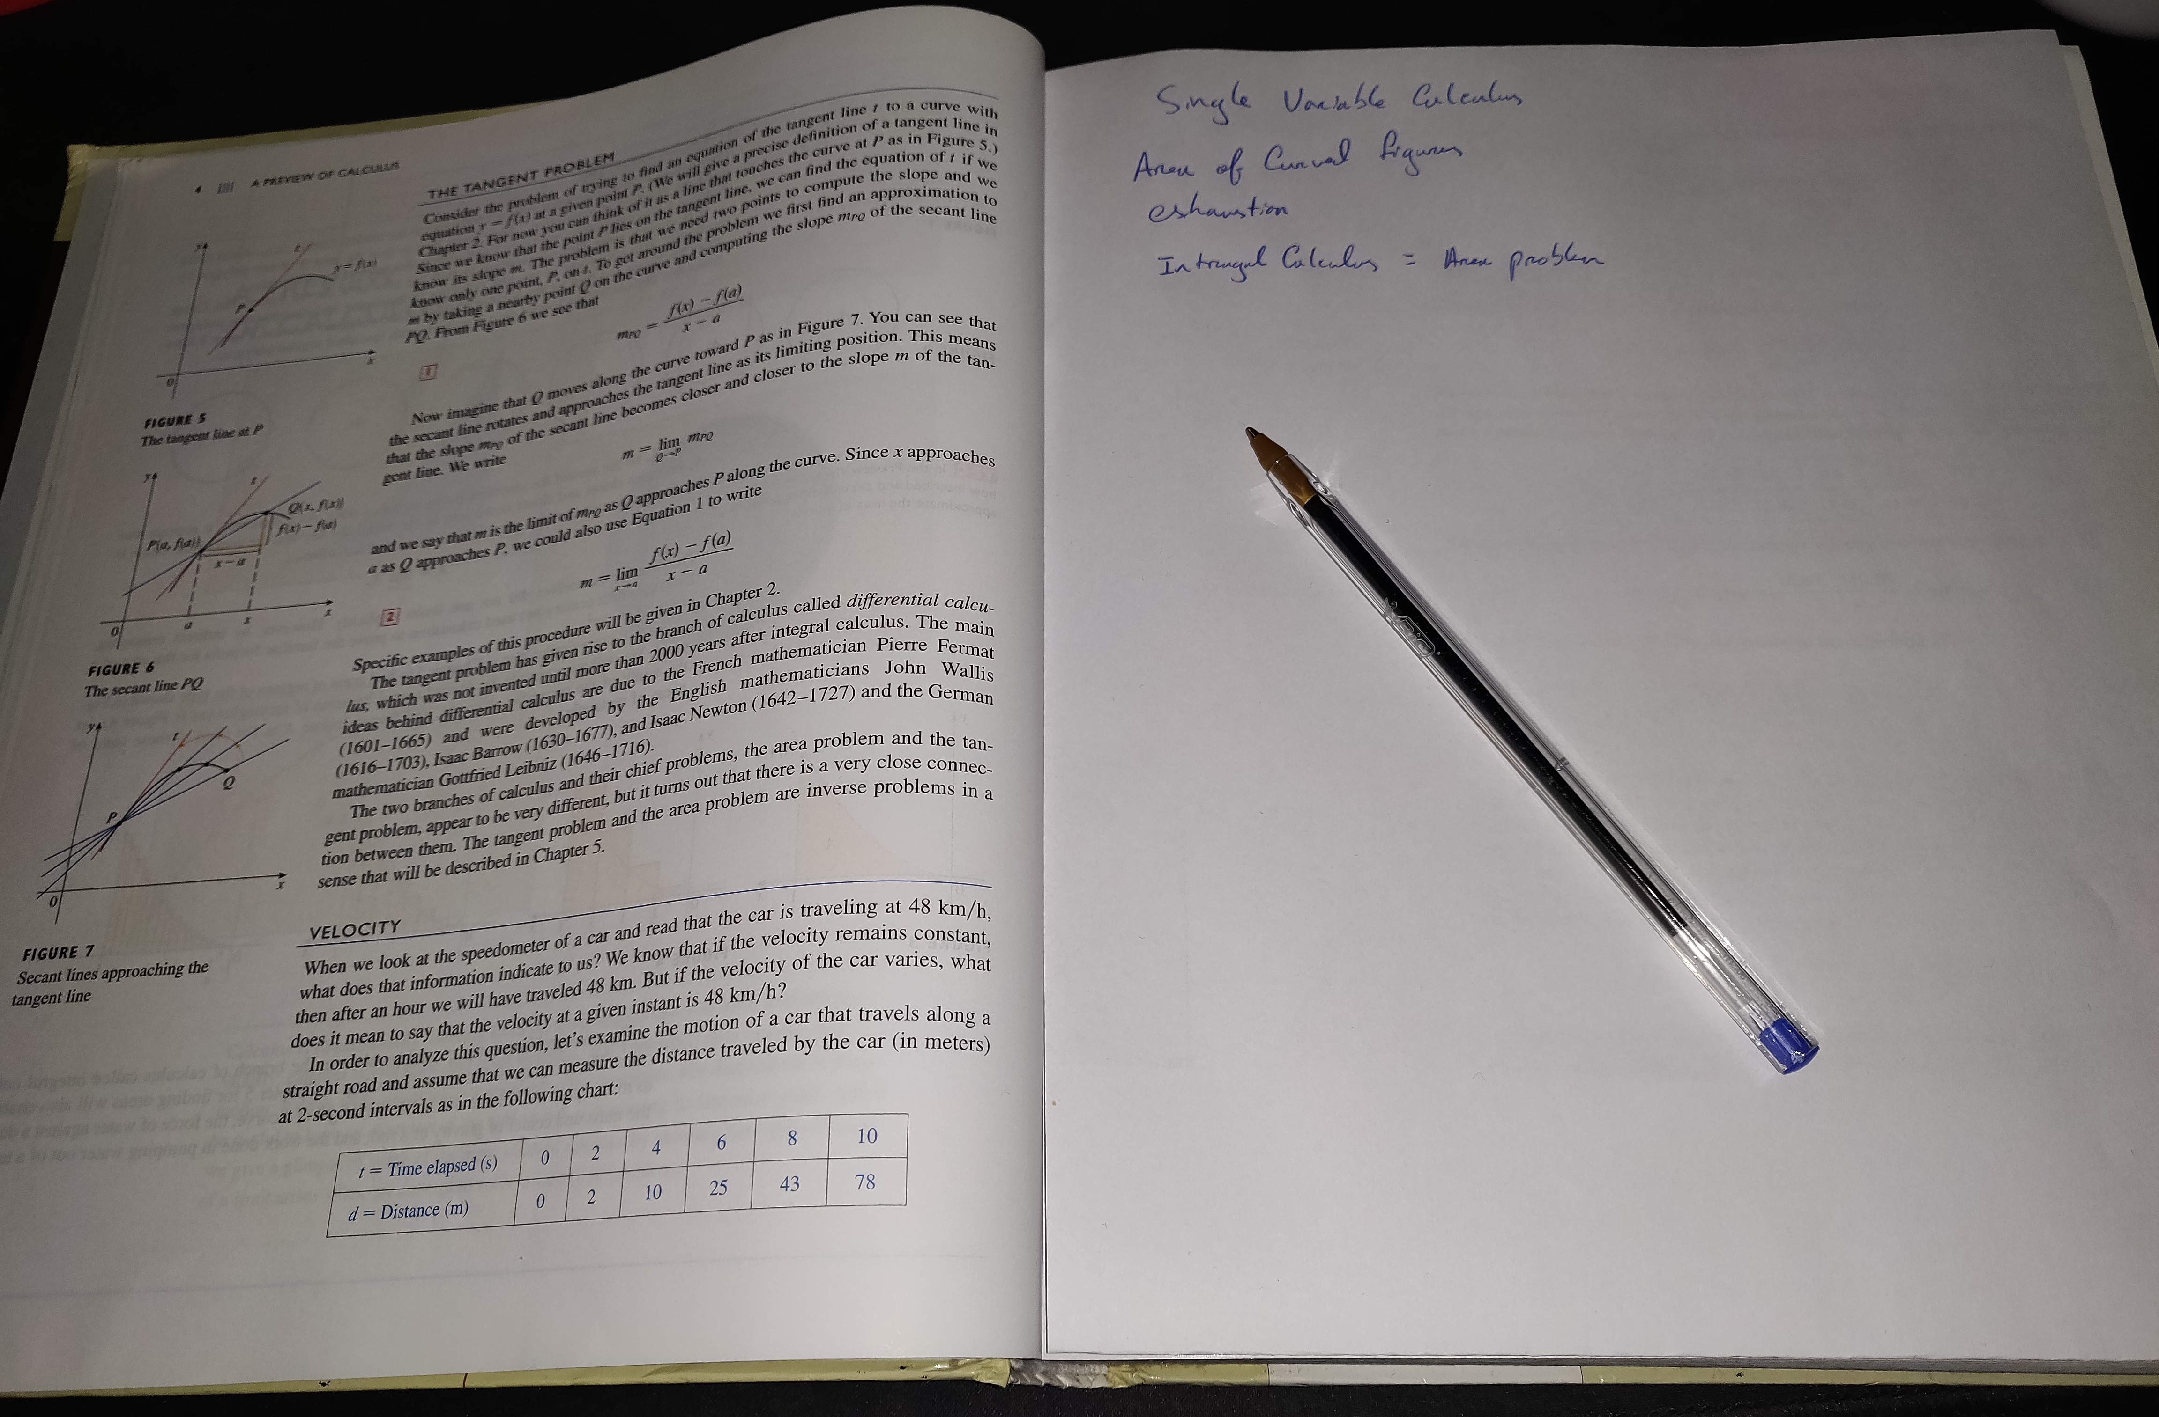
Introduction
Picture a book with a blank sheet of paper slotted between each page.
As you read, you take notes. Flip to the next page, a new sheet awaits you.
When it’s time to revise, you go back to that page and your notes on the topic are right there.
This is the feeling Note Reader wants to achieve.

Slide 3
Project Summary
NoteReader is a study solution that provides an all-in-one interface for document reading and note-taking. Each Page of Notes is directly tied to a page of the source document.
The core interface of NoteReader is the Split-View.
Left Pane: “true to intent rendering” of a wide range of common file types, including PDFs, Word Documents, PowerPoint slides, and eBooks. | Right pane: Text editor with Markdown and HTML rendering, to allow for richly formatted notes.
Notes and source material are stored together in a searchable catalogue
Notes:
The motivation of this project is to address flaws in currently available not taking solutions that I have observed in my time in college.

Slide 4
Background Research
E. M. Stacy and J. Cain, “Review note-taking and handouts in the digital age. 2015
Advocates for a “skeletal” handout structure to provide cognitive scaffolding, while encouraging engaging with material without full transcription.
The above would be well supported by a split-pane application like Note Reader.
D. Sun and Y. Li, “Effectiveness of digital note-taking on students’ performance in declarative, procedural and conditional knowledge learning,” International Journal of Emerging Technologies in Learning, vol. 14, pp. 108–119, 2019
Shows evidence of small performance benefits to digital note taking, especially in declarative knowledge.
Structure of Note Reader application may further support conditional knowledge, by ensuring context remains intact.
B. Artz, M. Johnson, D. Robson, and S. Taengnoi, “Taking notes in the digital age:
Evidence from classroom random control trials,” Journal of Economic Education, vol. 51, pp. 103–115, 4 2020.
No statistically significant difference found between digital and handwritten notes on retention.
Topics dependant on diagrams/mathematical elements may give advantage to traditional note taking.

Slide 5
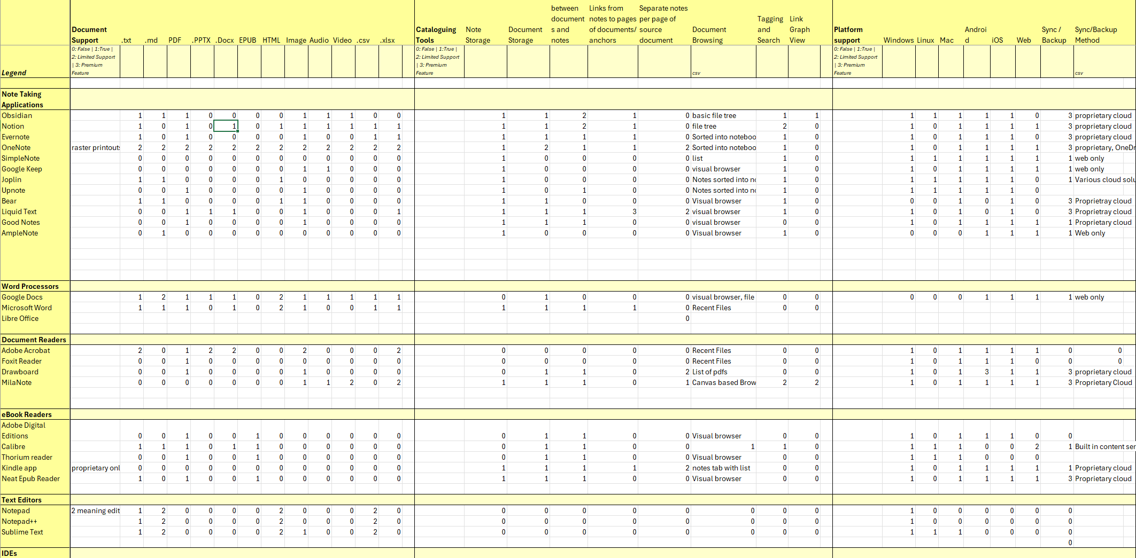
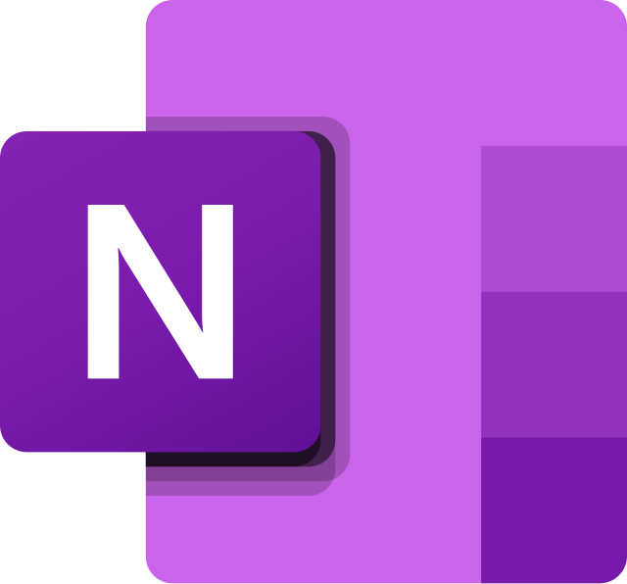





Existing Solutions
32 programs were reviewed, to determine current levels of support offered by existing solutions.
The programs were categorized and checked against a list of features.
Notes:
Taking One Note as an example, as it is the closest to my current idea, documents can be printed and annotated. With handwriting or text But this is destructive and costly. All documents are converted to raster. Categories include:
Note applications
Document readers
Word Processors
E-book readers
Text editors
IDEs
Features include:
Document Support
Platform Support
Cataloguing tools.
Pricing
Cloud features

Slide 6
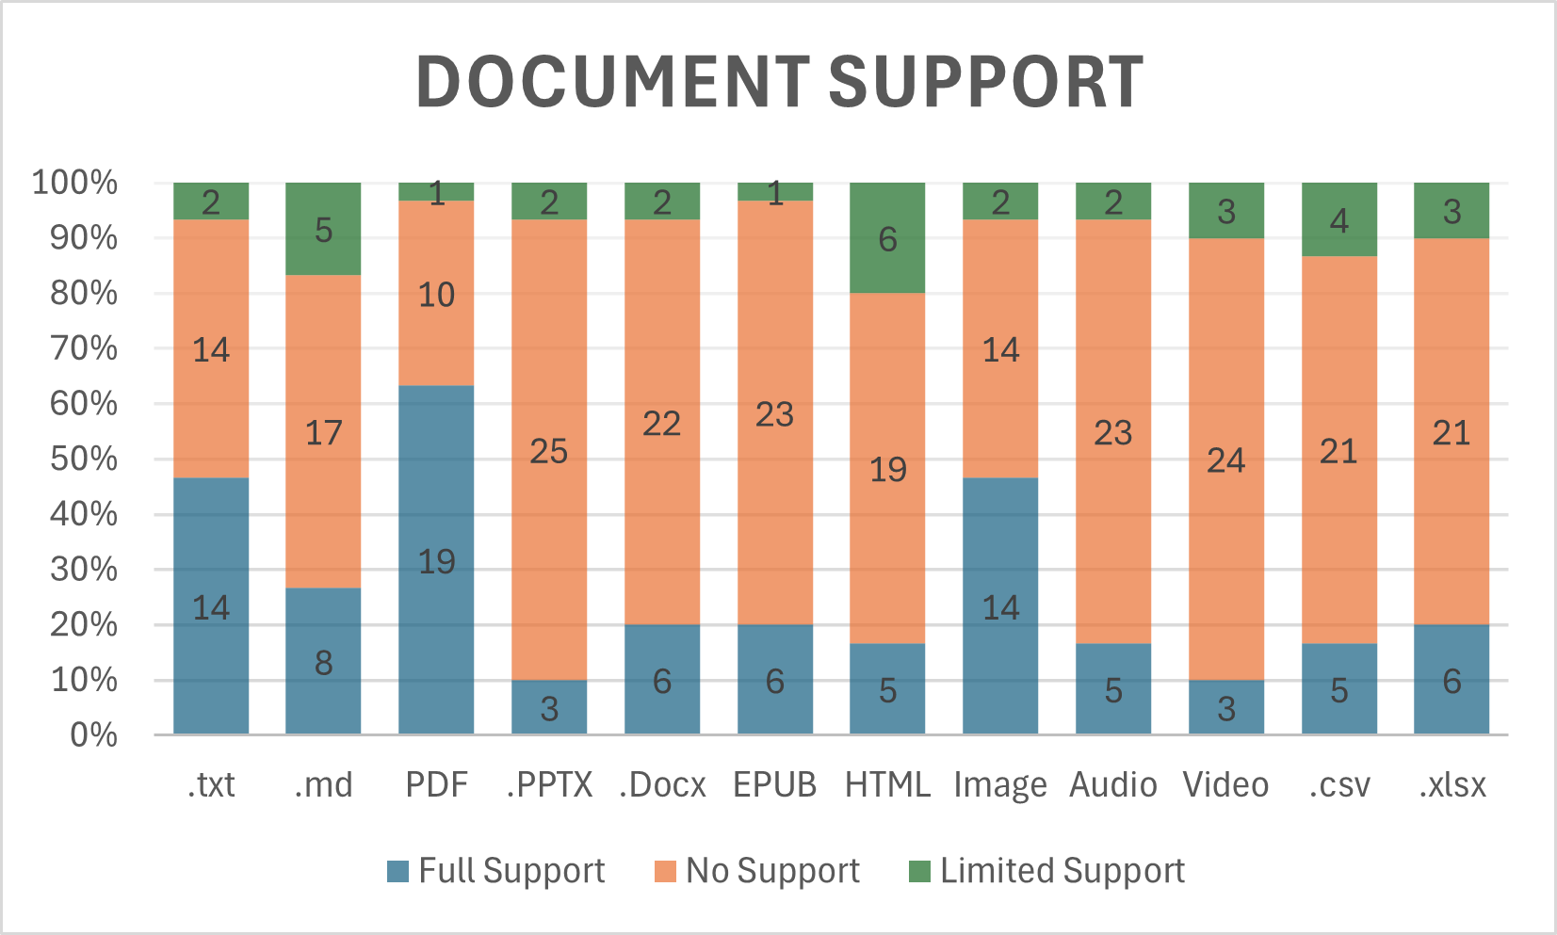
Existing Solutions
Notes:
Most support a small number of file types.
Very few a wide range.
Those which do often modify the original destructively, eg printing to a canvas.

Slide 7
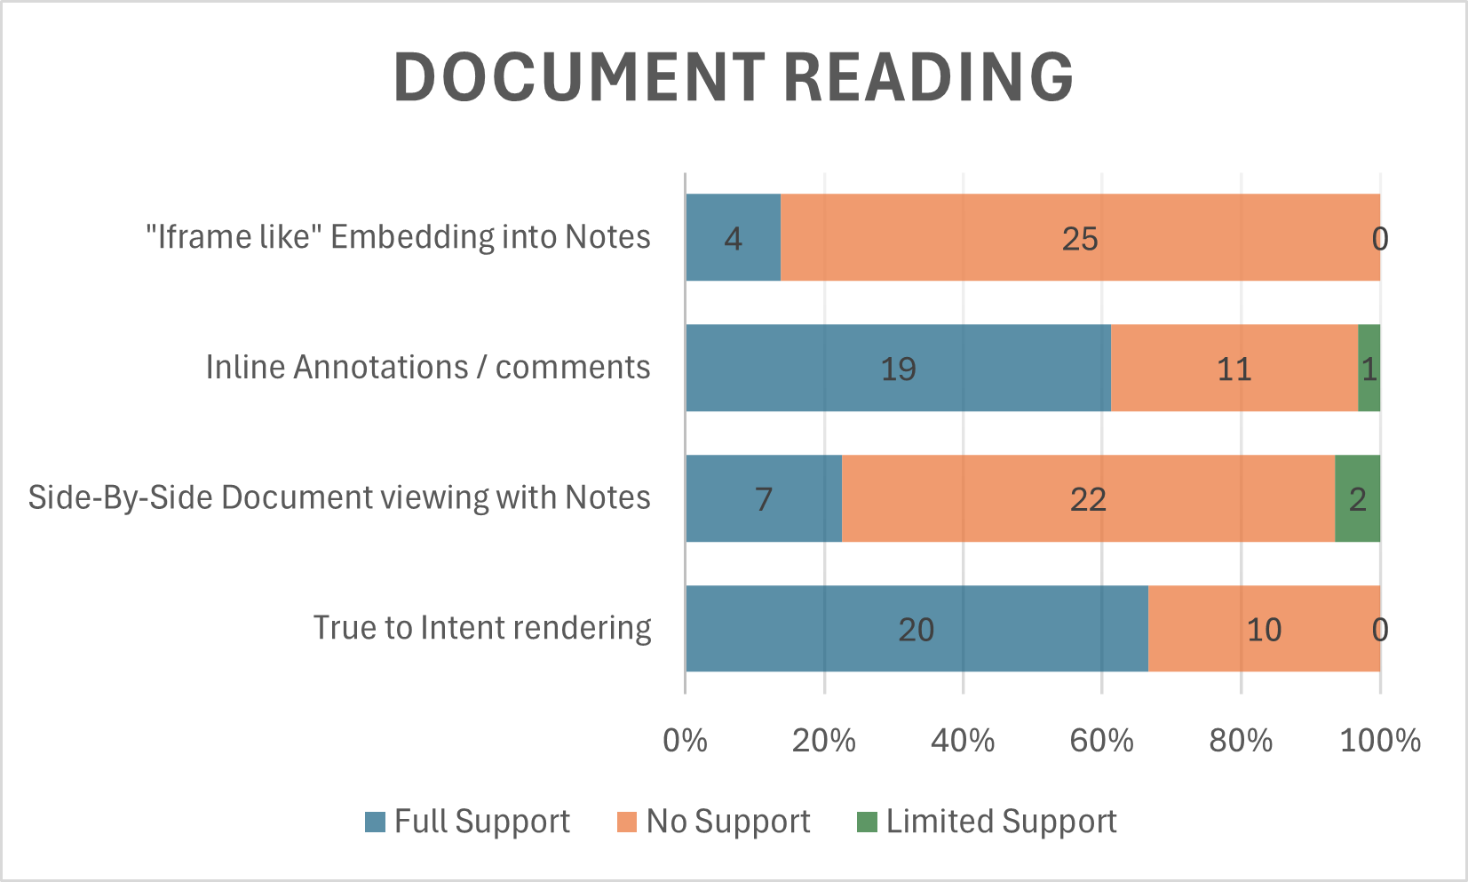
Existing Solutions
Notes:
Some useful features, like including an image or other content within the notes feed. Achievable through markdown.

Slide 8
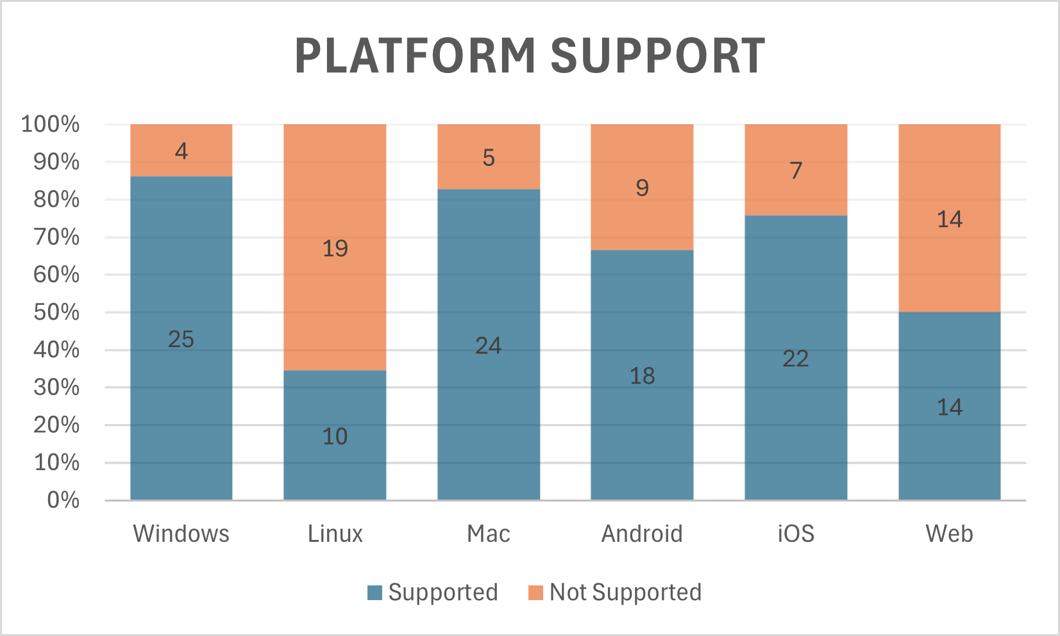
Existing Solutions
Notes:
Linux support lacking. Most applications don’t support many platforms.

Slide 9
Current Issues
Fragmentation of Tools
Document readers have weak support for note taking, and vice versa.
Limited Multi-Platform Support
Linux support is rare. Cross functionality is a challenge.
High Cost of Subscription Services
Especially for cloud storage, and accessing data on multiple devices.
Inadequate File Type Support
Power Point support is especially rare
Manual Organization and Storage
Loss of Context, misplaced documents, wasted time.
Notes:
- Non portable annotations,
bespoke file types,
large file sizes, small at first, adds up over time, continual cost from that point on.
- No application supports a page of notes per page of document. - Those which are close, do so using a canvas with destructively printed documents.

Slide 10
Problem Definition
Despite the availability of numerous note-taking applications and document readers, there exists a significant gap in the seamless integration of these two functionalities.
The primary objective is to develop a cohesive system that allows
users to read and annotate documents, create linked notes, and access these materials in an organized and intuitive manner, without destructively modifying the source material.
Notes:
All-in-one, platform-agnostic application that treats both document reading and note-taking as first-class priorities

Slide 11
Unique Value Propositions
Side-by-Side document reading and note taking
Support a wide Range of commonly used document types
Multi-Platform Design approach
Git-based file Synchronization
Notes:
Why Git: Git is an open source solution which supports version control.

Slide 12
Implementation Approach
User centric design approach
Agile based project management, through Scrum.
Core application, with abstract GUI interfaces to ensure consistency across platforms.

Slide 13
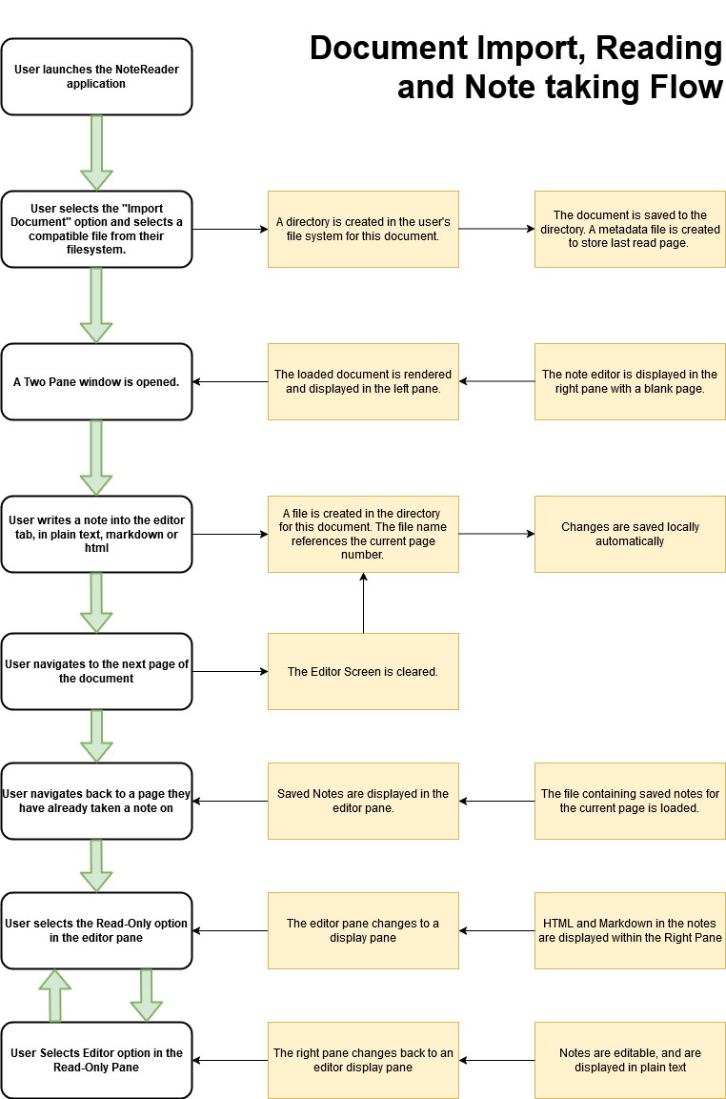
Flow diagram describing the basic user flow.
Shows the process of:
Opening a document
Taking Notes
Navigating between pages
Swapping between Editing and Rendering modes

Slide 14
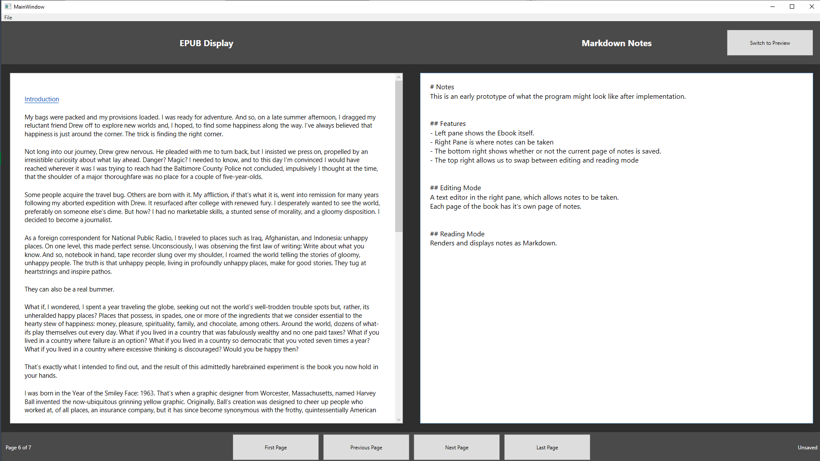
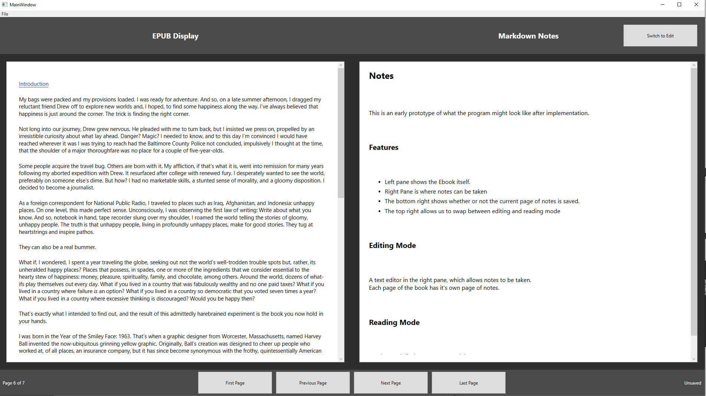
Desktop Application
Editing mode
Rendering Mode
Notes:
A preview of what the desktop application may look like, two pane display

Slide 15
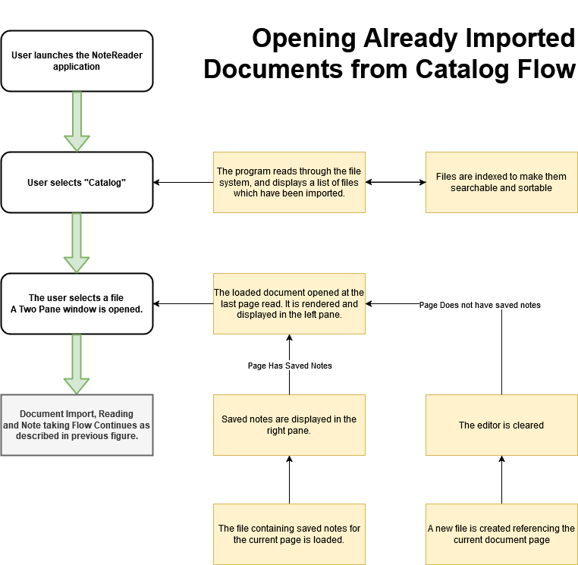
Flow diagram describing user flow of re-opening a document which is already in the catalogue.

Slide 16
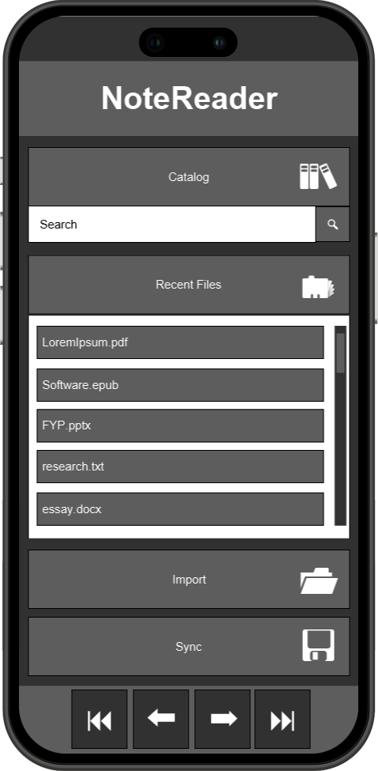
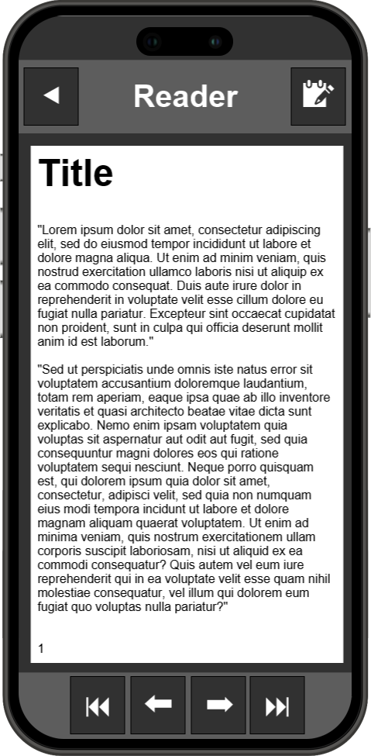
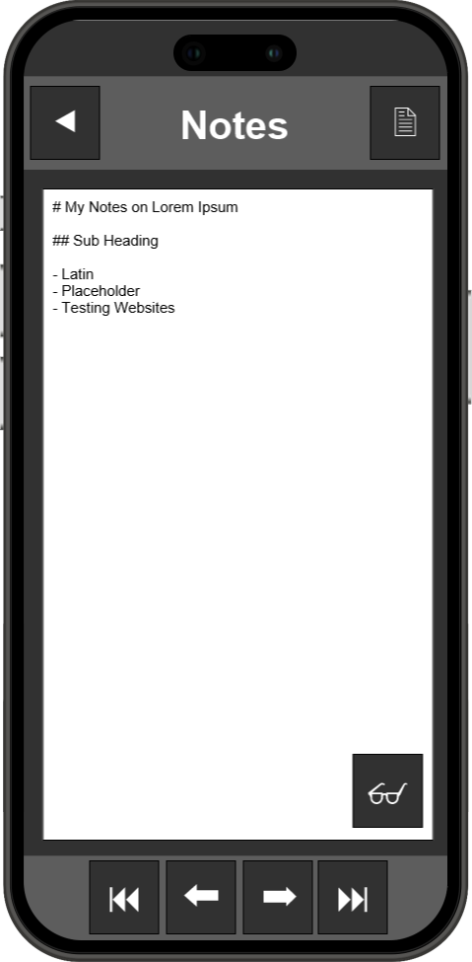
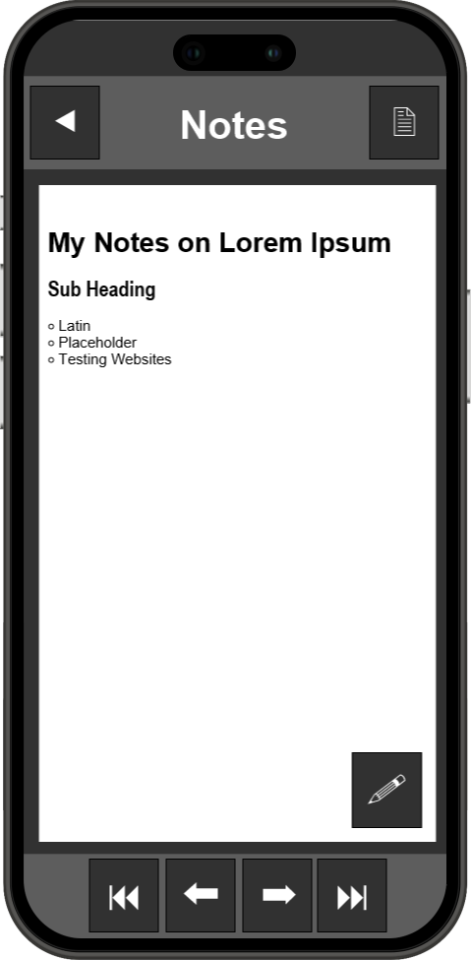
Mobile Application
Main Menu
Document Reader
Note Editor
Note Rendering
Notes:
Mobile prototyping
Recent files
Search
Top right button to switch between document and notes, bottom right to swap between rendered and editing notes.

Slide 17
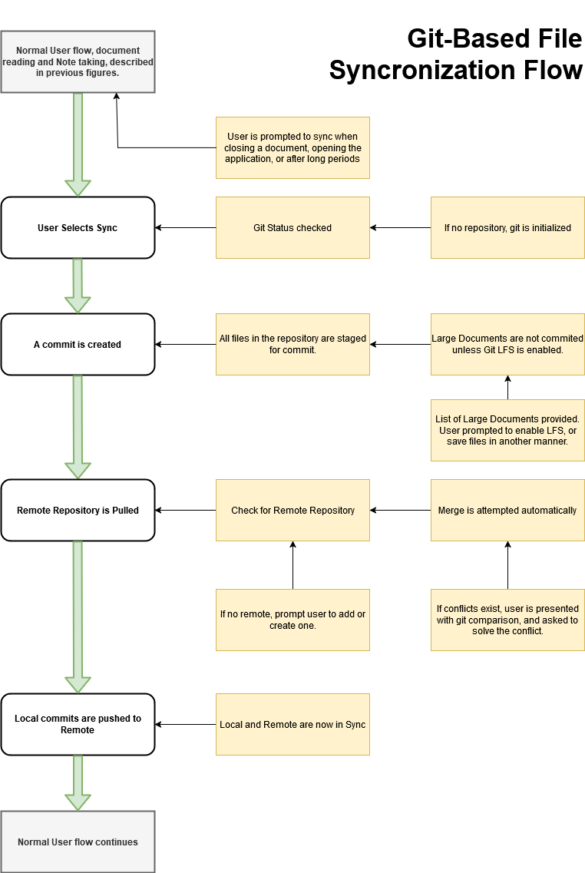
Flow diagram describing the process of syncing using Git.
Shows the process of:
Committing changes
Updating the project
Resolving conflicts
Pushing to remote

Slide 18
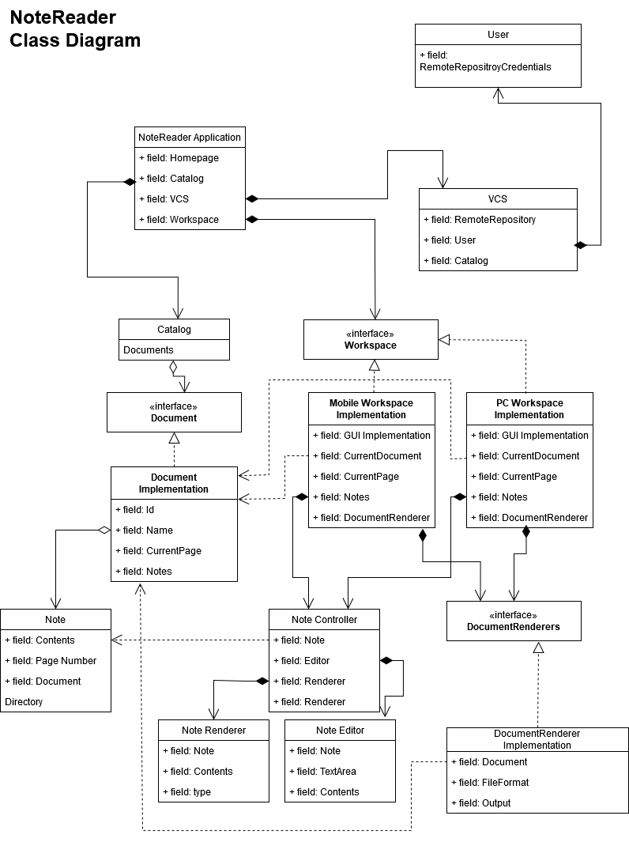
Central Application, build in Kotlin Multiplatform
Platform specific GUI and Document rendering implementations are abstracted by interfaces

Slide 19
Implementation Plan Schedule
Sprint 1
Sprint 2
Sprint 3
Sprint 4
Sprint 5
Sprint 6
PDF and Text Editor with Linked Pages
Document and Note Cataloguing and Search
Improved Document Format Support
Version Control and Sync
UI/UX Enhancements
Prototyping and Integration of Additional Features
Notes:
Six sprints of approximately two weeks each, approximately 30 hours of development per Sprint. ~200 hours total.
Early production of executables will allow for frequent user testing and iteration.

Slide 20
Out of Scope
AI Integration
Optical Character recognition
Handwriting
Web Interface
Real-Time Collaboration
Cloud-Only Storage
Notes:
The learning process of engaging with material and encoding important information into notes is the primary focus.
Improvements of fundamental tooling is the goal, rather than chasing current trends.
The current design is local storage centric. This is to ensure the user stays in control of their data, and we don’t need to pay for hosting.
For this reason, some useful features such as web interface and Cloud-Only Storage are out of scope for the first development cycle.

Slide 21
Conclusions
There is a clear gap in the features offered by currently available applications. None treat both note taking and document reading as first class priorities.
The proposed application will create a seamless integration between these features, encouraging real time engagement with material.
Will support engagement with source material, encoding notes rather than transcribing all content.

Slide 22
Thank You!
Questions and comments welcome

